Slide 1

AI Hospital Receptionist System
A Full-Stack AI-Based Healthcare Application
Shubham Dubey

Slide 2

INTRODUCTION
Transforming Hospital Reception Through AI
Hospital reception desks face overwhelming patient volumes daily, creating bottlenecks that affect the entire healthcare delivery system. Manual registration processes lead to significant delays, particularly during peak hours when patients need care most urgently.
Artificial intelligence offers a transformative solution by automating patient interactions whilst maintaining the personalised care patients expect.
This project introduces an innovative AI-based receptionist system designed to streamline patient intake, reduce administrative burden, and enhance the overall hospital experience.

Slide 3
PROBLEM STATEMENT
Critical Challenges in Hospital Reception
Extensive Queue Times
Manual Data Entry Errors
Patients experience prolonged waiting periods at reception desks, leading to frustration and delayed treatment. Peak hours can see queues extending beyond reasonable limits, particularly affecting vulnerable populations.
Human error in transcribing patient information creates risks in medical records. Illegible handwriting, misheard details, and fatigue-related mistakes compromise data accuracy and patient safety.
Emergency Case Delays
Staff Workload Pressure
Critical cases may not receive immediate attention when staff are overwhelmed with routine registrations. The inability to rapidly triage and classify patients creates potentially dangerous situations.
Reception staff face intense pressure managing high volumes of patients, administrative tasks, and phone enquiries simultaneously. This leads to burnout and reduced quality of patient interaction.

Slide 4
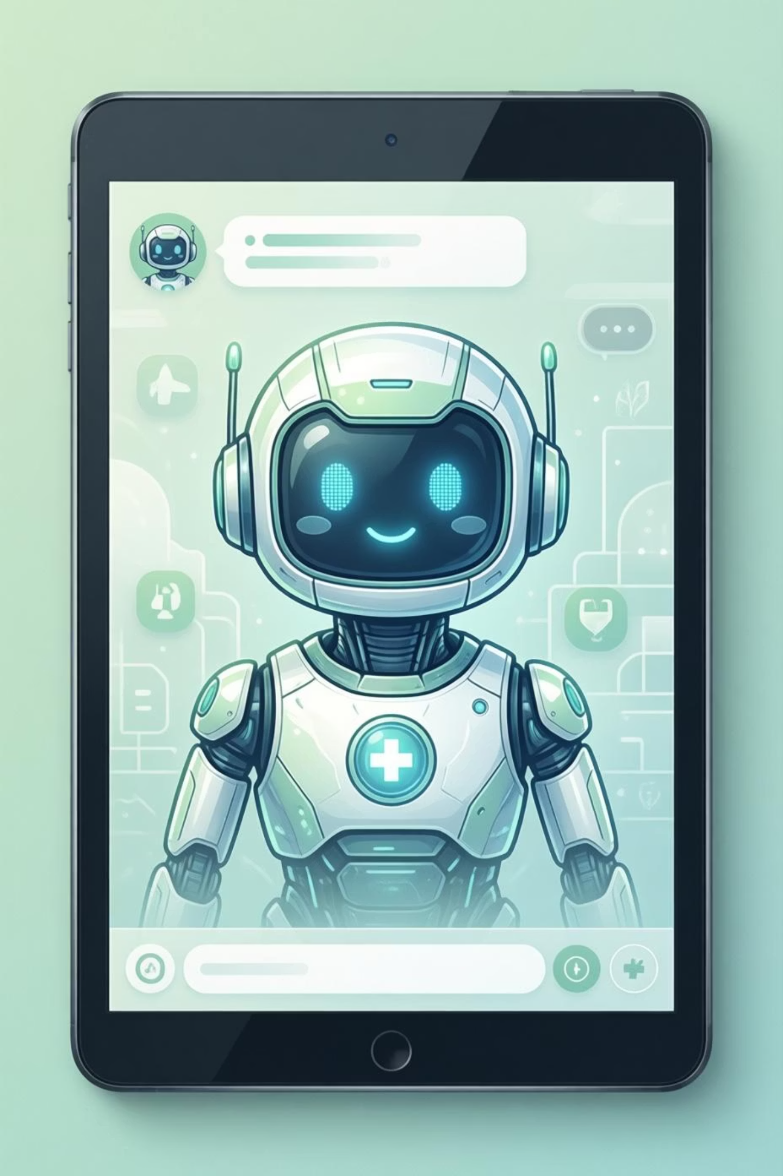

SOLUTION
Intelligent AI-Powered Reception System
01
AI-Powered Chat Interface
Conversational AI guides patients through registration using natural language processing, creating an intuitive and accessible experience for all age groups.
02
Structured Data Collection
The system methodically gathers essential patient information through a step-by-step dialogue, ensuring completeness whilst maintaining conversation flow.
03
Automatic Ward Classification
Intelligent algorithms analyse patient symptoms and requirements to recommend appropriate departments, streamlining the triage process significantly.
04
Secure Digital Storage
Patient data is encrypted and stored in cloud-based systems, ensuring HIPAA compliance whilst enabling authorised staff to access records instantly.

Slide 5





TECHNICAL ARCHITECTURE
System Architecture Overview
Frontend Layer
React framework with Tailwind CSS delivers a responsive, modern interface optimised for both desktop kiosks and mobile devices.
Backend Services
FastAPI powered by Python handles business logic, API endpoints, and AI processing with high performance and scalability.
Data Storage
Supabase provides secure, cloud-based PostgreSQL database with real-time capabilities and robust authentication systems.
Communication
RESTful API architecture ensures seamless data exchange, with optional webhook integration for external system notifications.

Slide 6
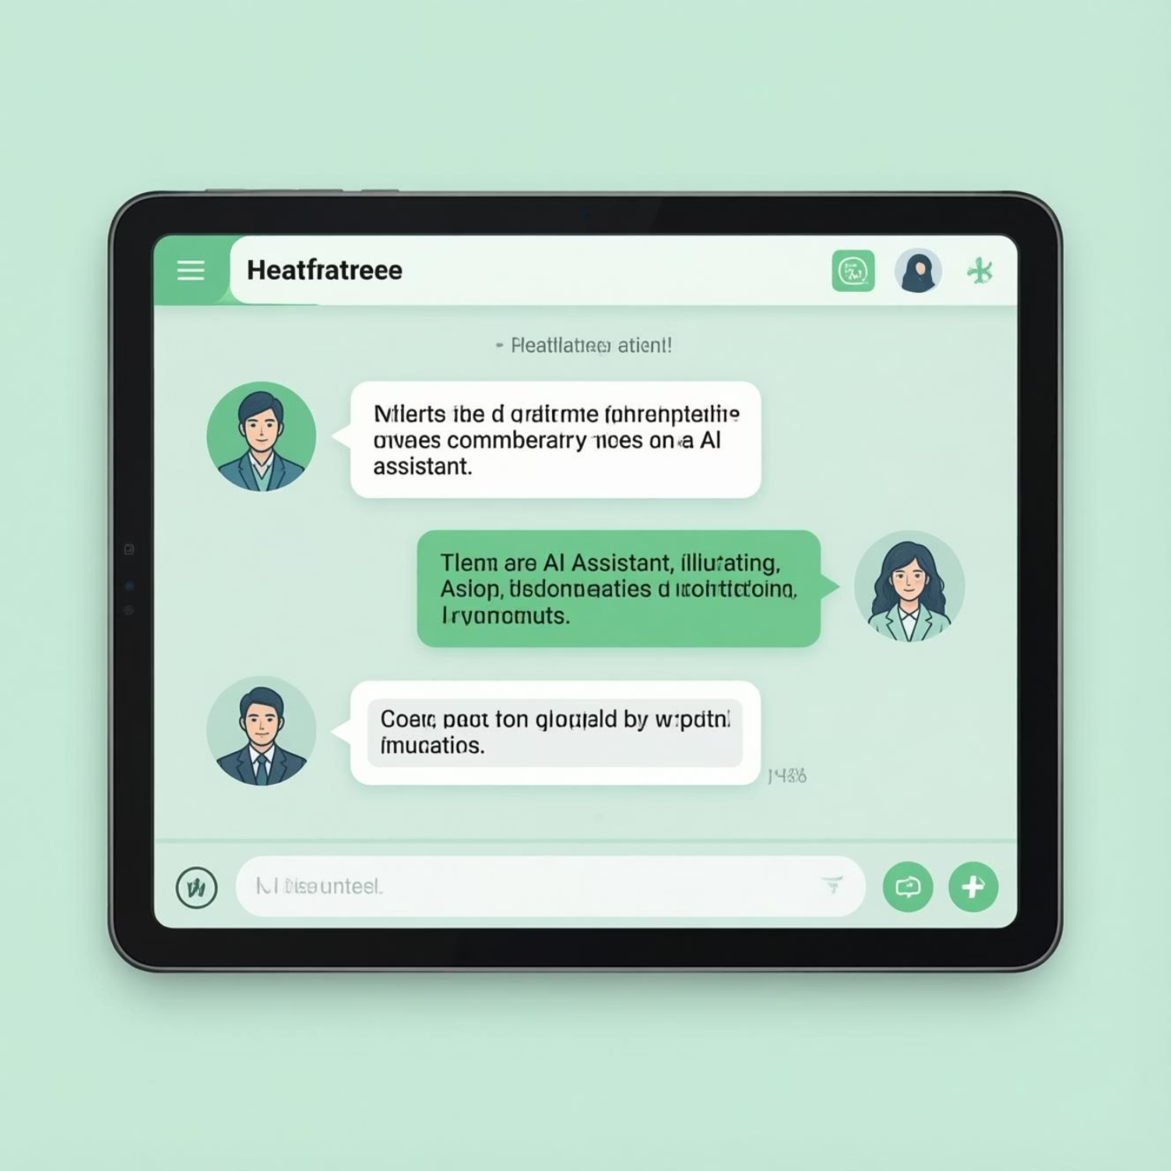
USER INTERFACE
Interactive Chat Interface
Intuitive Patient Experience
The chat-based interface provides a familiar, conversational experience that guides patients naturally through the registration process.
Clean, responsive design adaptable to various screen sizes
Clear visual feedback and progress indicators
Accessibility features for diverse patient needs
Real-time validation and helpful error messages
Patients engage with the system as they would with a human receptionist, asking questions and receiving immediate, contextual responses.

Slide 7

Complete Registration Flow
Initial Greeting
Symptom Analysis
Patient initiates conversation with a simple hello. The system responds warmly and explains the registration process.
Patient describes their medical concern. The AI analyses the input to understand urgency and appropriate department routing.
1
2
3
4
Information Collection
Confirmation & Completion
System progressively asks for essential details: age, symptoms, medical history, and contact information through natural dialogue.
System summarises collected information, assigns ward recommendation, and confirms successful registration with next steps.

Slide 8
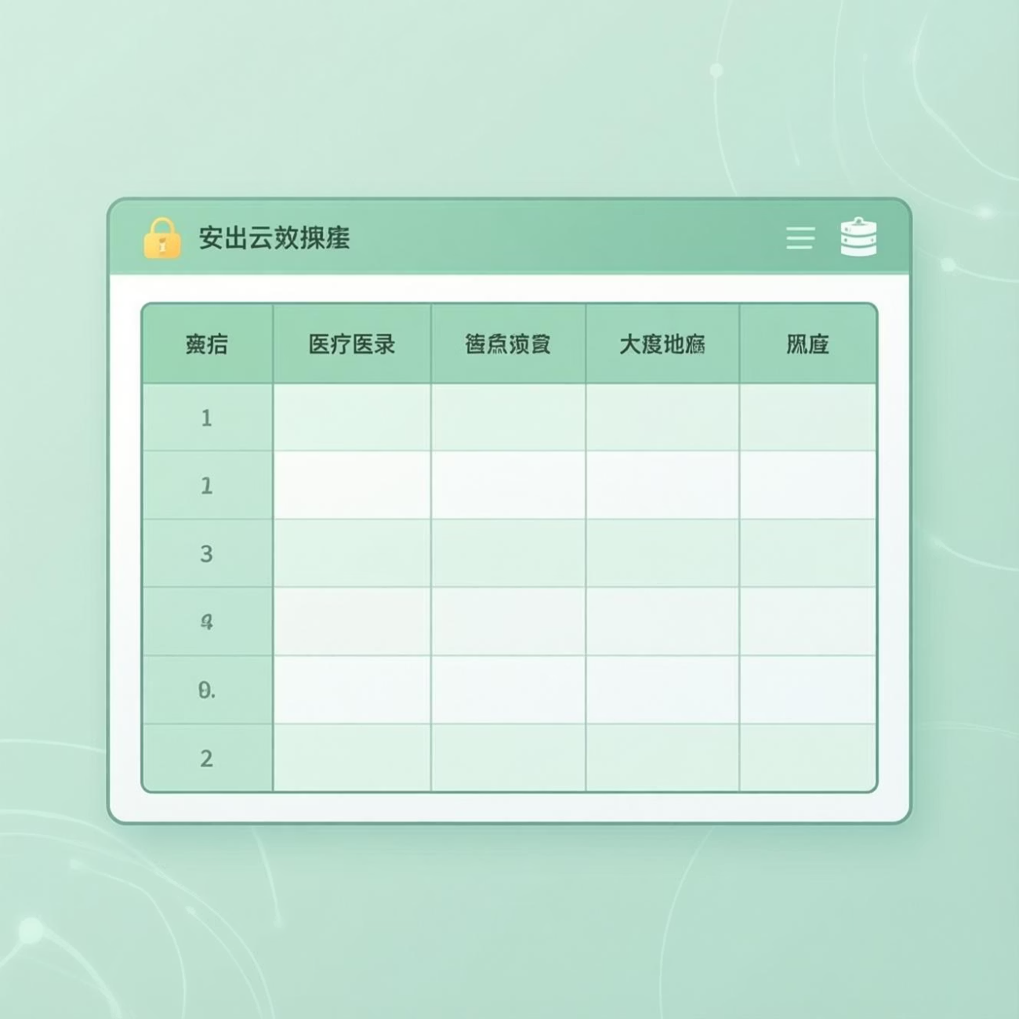

DATA SECURITY
Secure Cloud-Based Storage
Robust Data Management
Patient information is securely stored in Supabase, a cloud-based PostgreSQL database that provides enterprise-grade security and reliability.
The system maintains structured medical records with complete audit trails, ensuring data integrity and compliance with healthcare regulations.
End-to-end encryption for sensitive health data
Role-based access control for medical staff
Automated backups and disaster recovery
GDPR and HIPAA compliance measures
All patient data is anonymised for analytics whilst maintaining complete records for authorised medical personnel.

Slide 9
IMPACT & OUTCOMES
Benefits & Learning Achievements
System Benefits
Technical Learning Outcomes
Full-Stack Development
Gained comprehensive experience building integrated frontend and backend systems with modern frameworks.
Reduced Waiting Time
Patients complete registration in minutes rather than waiting in lengthy queues, improving satisfaction significantly.
API Integration Expertise
Developed skills in designing RESTful APIs and managing secure data communication between services.
Cloud Database Management
Enhanced Patient Experience
Mastered cloud-based database implementation, including security, scaling, and real-time data synchronisation.
24/7 availability and consistent service quality create a welcoming, efficient first point of contact.
Version Control Proficiency
Utilised GitHub for collaborative development, code management, and deployment workflows.
Streamlined Operations
Staff can focus on complex cases whilst routine registrations are handled automatically with greater accuracy.

Slide 10

Thank You
Questions?
Future Scope
Contact
I welcome your feedback and enquiries about the AI Hospital Receptionist System.
Shubham Dubey
Multi-language support, voice interface integration, and predictive analytics capabilities.
Available for discussion and demonstration

